Slide 1
Micro Credit Defaulter Project
Submitted by,
Poovarasi Vijayan

Slide 2
Content:
Introduction
Problem Statement
Insights of the project
Analytical Problem Facing
EDA
Visualizations
Data Pre Processing and Feature Engineering
Model Development and Evaluation
Conclusion

Slide 3
Introduction:
With the rapid growth of technology and increased competition, telecom firms are looking for ways to improve the quality of their service and, as a result, the health of their revenue. Miniature credit arrangement furnishes administrators and specialist organizations with the capacity to stretch out their support of their clients through a little, transient credit office.
At the point when we go through the dataset given, we should look at deliberately every one of the characteristics given, arrange the clients between defaulters and non-defaulters, and lesson the possibility od deceitfulness in miniature credit advance by clients.

Slide 4
Problem Statement:
A Microfinance Institution (MFI) is an organization that offers financial services to low-income populations. MFS becomes very useful when targeting especially the unbanked poor families living in remote areas with not much sources of income. The Microfinance services (MFS) provided by MFI are Group Loans, Agricultural Loans, Individual Business Loans and so on.
Many microfinance institutions (MFI), experts and donors are supporting the idea of using mobile financial services (MFS) which they feel are more convenient and efficient, and cost saving, than the traditional high-touch model used since long for the purpose of delivering microfinance services. Though, the MFI industry is primarily focusing on low-income families and are very useful in such areas, the implementation of MFS has been uneven with both significant challenges and successes. Today, microfinance is widely accepted as a poverty-reduction tool, representing $70 billion in outstanding loans and a global outreach of 200 million clients.

Slide 5
Problem Statement:
They understand the importance of communication and how it affects a person’s life, thus, focusing on providing their services and products to low-income families and poor customers that can help them in the need of hour.
They are collaborating with an MFI to provide micro-credit on mobile balances to be paid back in 5 days. The Consumer is believed to be defaulter if he deviates from the path of paying back the loaned amount within the time duration of 5 days. For the loan amount of 5 (in Indonesian Rupiah), payback amount should be 6 (in Indonesian Rupiah), while, for the loan amount of 10 (in Indonesian Rupiah), the payback amount should be 12 (in Indonesian Rupiah).
We are working with one such client that is in Telecom Industry. They are a fixed wireless telecommunications network provider. They have launched various products and have developed its business and organization based on the budget operator model, offering better products at Lower Prices to all value conscious customers through a strategy of disruptive innovation that focuses on the subscriber.

Slide 6
Business Goal:
To understand the business problem, there are certain features that influence the micro finance such as the borrowers are generally from low-income backgrounds, loans availed under microfinance are usually of small amount, i.e., micro loans, the loan tenure is short, microfinance loans do not require any collateral, these loans are usually repaid at higher frequencies, the purpose of most microfinance loans is income generation.

Slide 7
Insights of Project:
This problem is taken to Build a model which can be used to predict in terms of a probability for each loan transaction, whether the customer will be paying back the loaned amount within 5 days of insurance of loan. In this case, Label ‘1’ indicates that the loan has been paid i.e., non-defaulter, while, Label ‘0’ indicates that the loan has not been paid i.e., defaulter.

Slide 8
Analytical Problem Facing:
Analytic problem framing involves translating the business problem into terms that can be addressed analytically via data and modeling. Analytic problem framing is the antithesis of merely working with the ready-to-hand data and seeing what comes of it, hoping for something insightful.

Slide 9
Exploratory data analysis
In micro credit defaulter prediction project there are 209593 rows and 36 columns.
First, the analysis is started with importing the data, this dataset has no Null values in target column so continued with further analysis and unnecessary columns which does not contribute for the target variable is also dropped.
Once data is cleaned outliers and skewness are checked, if present they are removed then in Data Pre-processing, Standard Scaler is used to standardize the data and by using VIF, multicollinearity is removed.

Slide 10
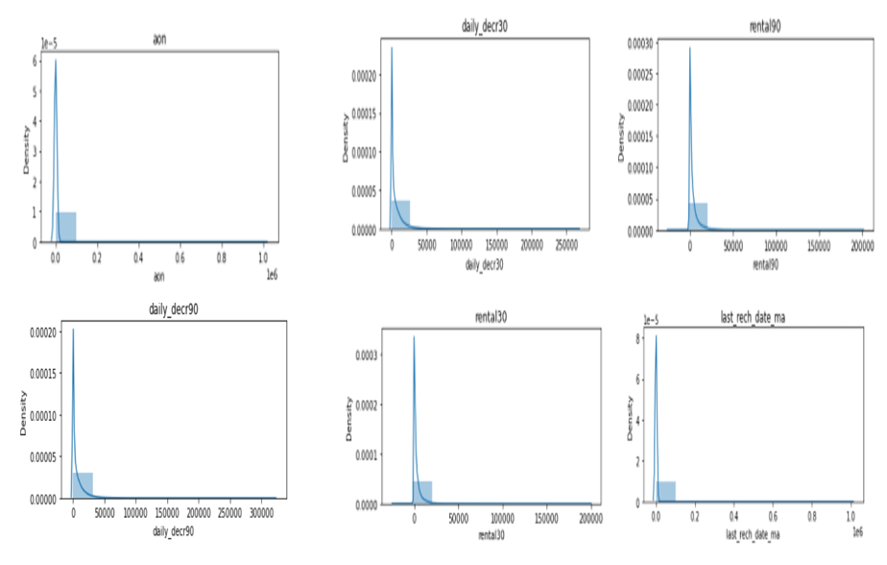
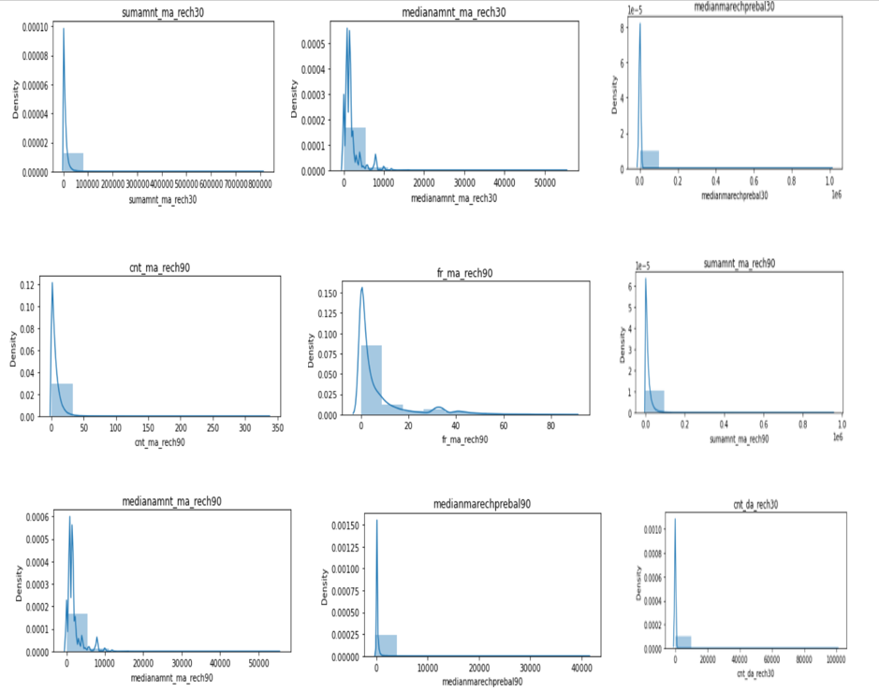
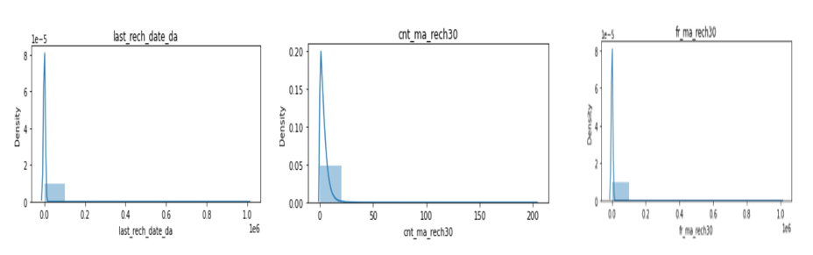
Visualization:

Slide 11
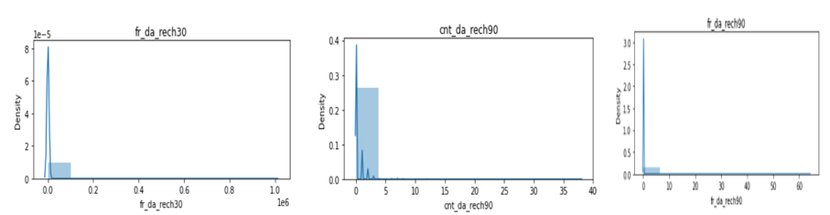
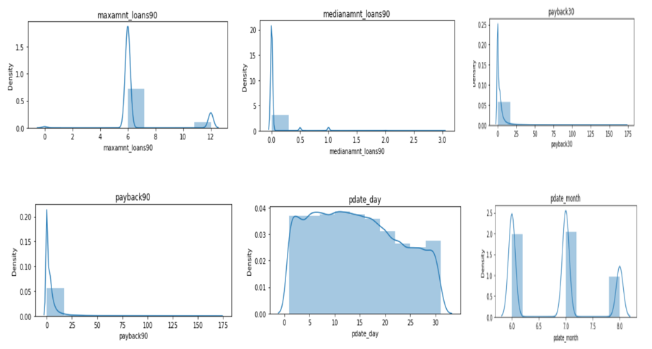
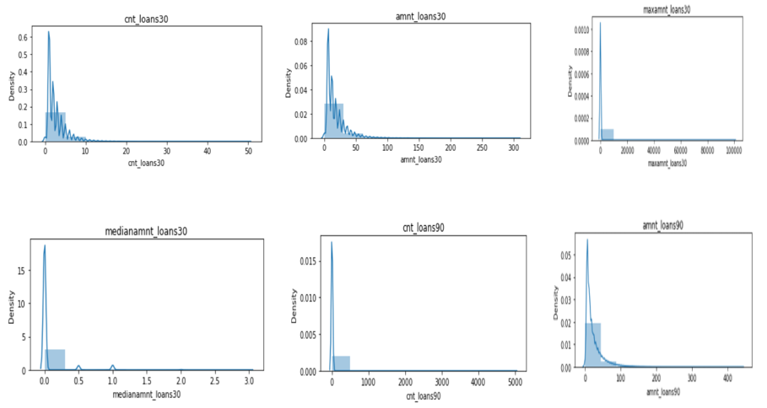
Cont.

Slide 12
Key Observation:
Most of our columns are extremely right skewed.
maxamnt_loans90 have only three values 6, 12, 0 and 6 is in the most of the record.
For fr_ma_rech90 the frequency of recharge in last 90 days the frequency is very lesser i.e. most of the people are recharging in very lesser time.
aon age on cellular network in days most of the people are actually lesser in age on cellular network.
rental90, rental90, average main balance over last 90, 30 days are mostly between 0 - 1500.

Slide 13
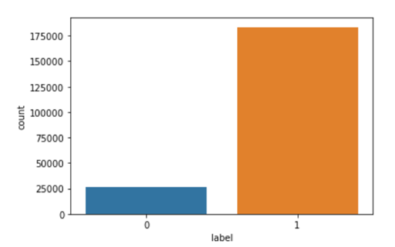
Cont.
We have large number of 1’s which means dataset is imbalanced.

Slide 14
Data Pre-Processing and Feature Engineering:
In Machine Learning, data pre-processing refers to the process of cleaning and organising raw data in order to make it appropriate for creating and training Machine Learning models.
In other words, anytime data is received from various sources, it is collected in raw format, which makes analysis impossible. Data pre-processing is a crucial stage in Machine Learning since the quality of data and the relevant information that can be cleaned from it has a direct impact on our model's capacity to learn; consequently, we must pre-process our data before feeding it into our model.
As a result, it is the first and most important stage in developing a machine learning model. Some of the techniques used in this project are listed below:
Started with importing the required libraries and then the train dataset which is in csv format.
As the dataset contains 36 variables. Then the information of the columns are observed carefully.

Slide 15
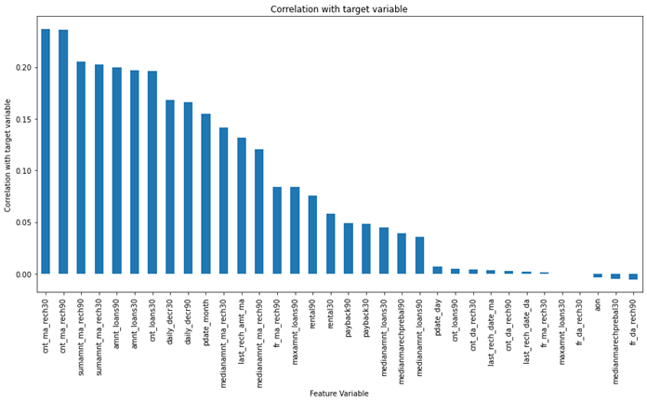
Correlation:
corr() is used to find the pairwise correlation of all columns in the dataframe.
'cnt_ma_rech30', 'cnt_ma_reach90' are highly correlated with the target column, whereas 'fr_da_rech90' is less correlated with target column.

Slide 16
Outliers:
An outlier is an observation that lies an abnormal distance from other values in a random sample from a population.
In this project mostly all columns contains outliers which is visualized in next slide.
These Outliers are removed by Z-Score.

Slide 17
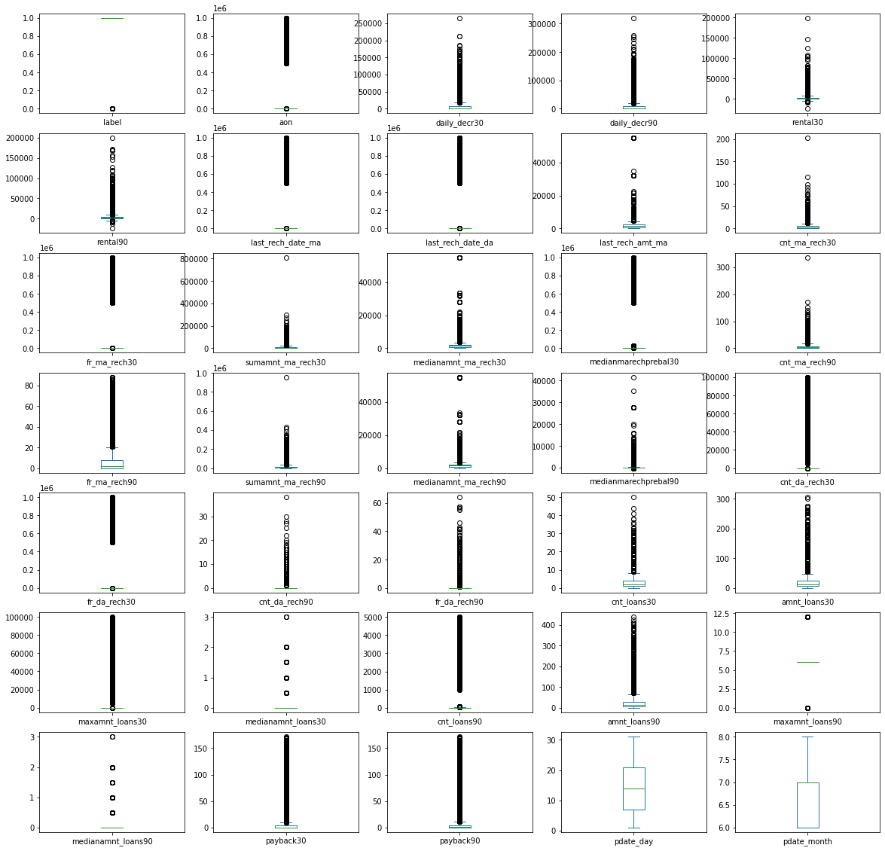

Slide 18
Skewness:
Skewness refers to a distortion or asymmetry that deviates from the symmetrical bell curve, or normal distribution, in a set of data.
Keeping skew values +/- 0.5 we can find that most columns have more value of skew.
Here in this project, power transform method is used to remove skewness and to get high accuracy of the model.

Slide 19
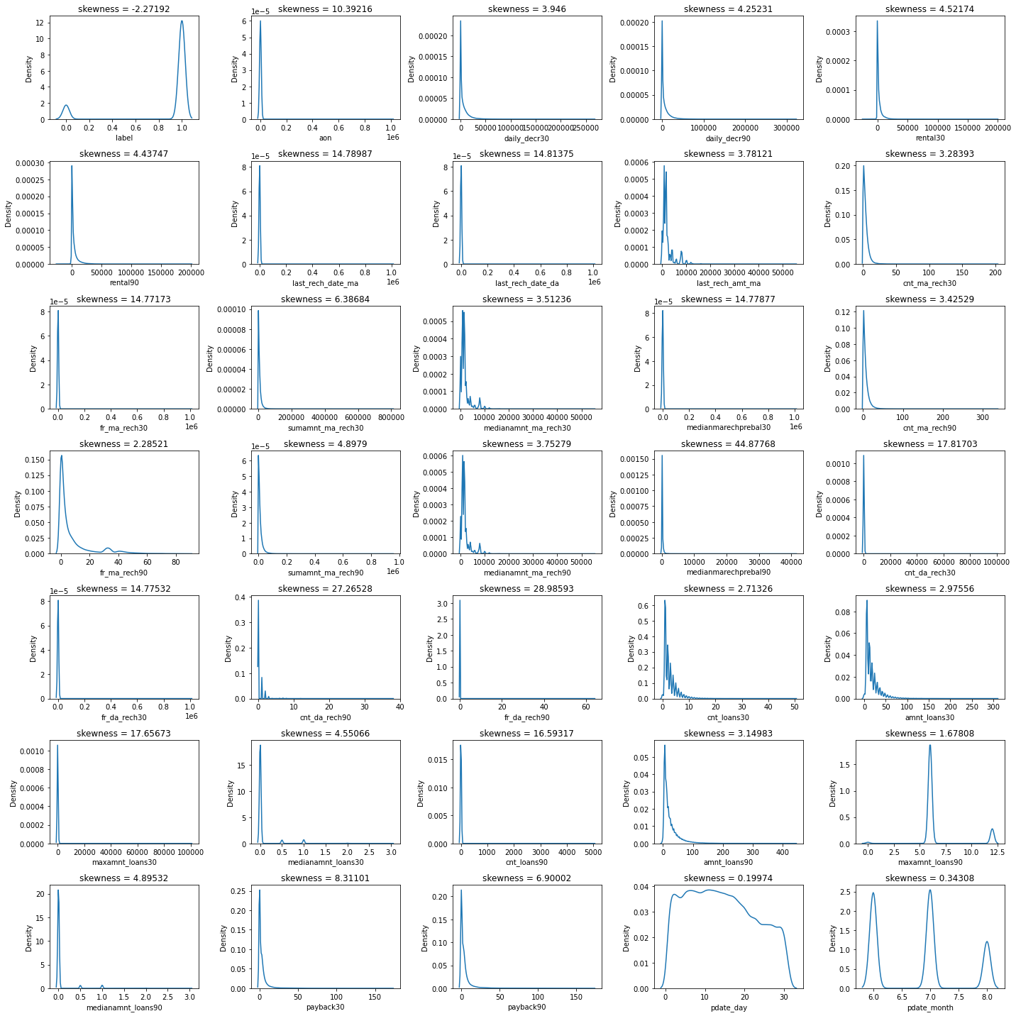

Slide 20
Cont.
Outliers and Skewness is checked and removed in order to avoid bias while model building.
Standard Scaler is used for data standardization and VIF is used to check Multicolinearity is checked to find if any data variable is correlated with each other and it is removed.
Once all these processes are done then data is ready for model building where various Machine Learning models is used to check the accuracy of data.

Slide 21
Model Development and Evaluation
The approaches followed in this project are
Find the best random state of a model.
Use all the other models to find accuracy score, mean squared error, mean absolute error and r2 score.
Then find Cross Validation of all models to find the best accuracy, which is the least difference between r2 score and cv score.
With the best model accuracy, we need to do hyper tuning using GridSearchCV.
Then finally saving the best model and by keeping this we need to predict the ticket Price of test dataset.

Slide 22
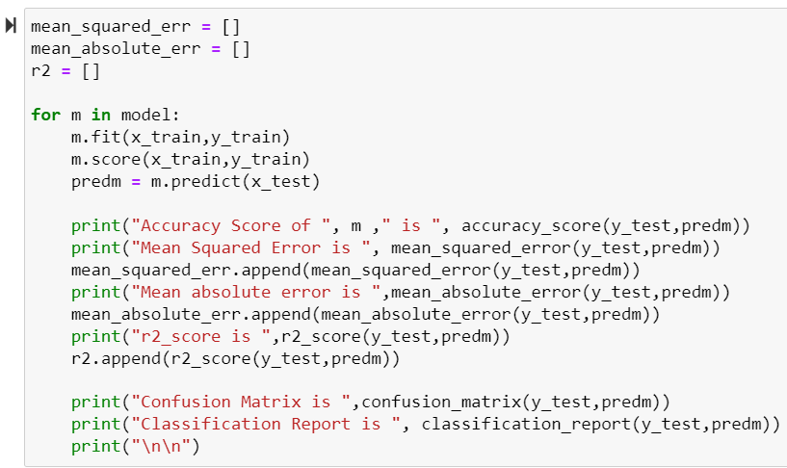
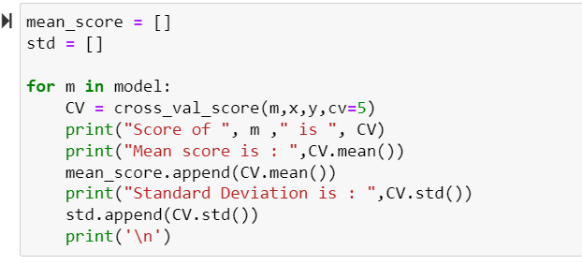
Here accuracy score,r2_score, mse , confusion matrix, classification report ,cv is checked for all models and final model is selected.

Slide 23
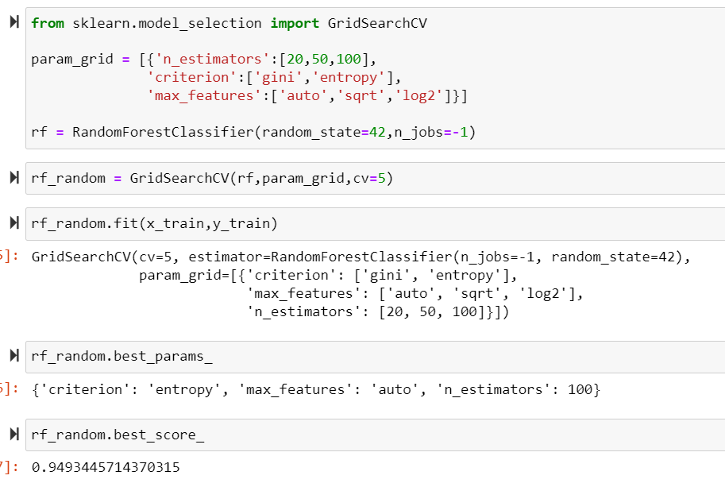
HyperTuning:
Hypertuning is done to improve model accuracy for RandomForestRegressor. By which we improved our accuracy to 94.93 percent.

Slide 24
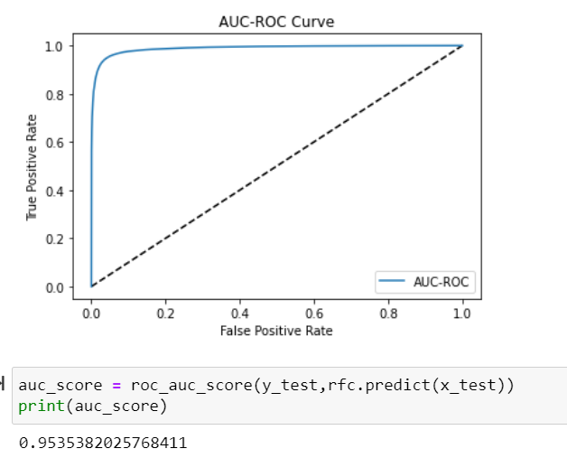
AUC-ROC Curve
With AUC-ROC we get 95.35% accuracy.

Slide 25
Conclusion:
Around 28% users are highly defaulters with a mostly negative or null balance.
Users with high equilibrium and a much lower number are defaulter.
Nonstandard loans (i.e.,98 percent of the category) are paid to users who take up more loans as they pay back the loan within 5 days
10% to 12% of users are defaulters in the Average and Low Balance categories.
Non-defaulting users who have taken no loans. Around 97% users are taking large loans which fall into non-default categories.
Defaulters include 40 percent of the users that do not have a single recharge in 3 months.
Around 14 percent of users fall into the category of defaulting loans, on average.
The default is only 40% of users who do not reload in 90 days.
Users who recharge very high pay their loans on time. That is, 98% of them are non-defaulting ones.

Slide 26
Conclusion:
Defaulting is 34 percent of users who reload less.
Old and largely non default users are trusted
17% of users receiving small loans are non-performing.
The new users constitute 32% of the users defaulting.
Of users who recharge and pay their loans on time, 99 percent are more in number, which is good news for the company than for any other category.

